Slide 1


Understanding the Location Decisions of cmha’s Housing Choice Voucher holders: 2015 pilot study
Center for Community Planning and Development
Presented by Kathryn W. Hexter, Director Center for Community Planning and Development
Notes:
Co-authors: Brian Mikelbank, Dennis Keating, Mittie Olion Chandler and Joyce Huang

Slide 2
Our study—Three questions
How do housing choice voucher holders decide where they want to live?
What are the barriers that might be preventing voucher holders from moving to areas of greater opportunity?
How can CMHA partner with cities to design programs that move voucher holders up and out of poverty?
Interviews with new voucher holders, movers, and landlords.
Notes:
In January 2005, 60% of voucher holders lived in Cleveland
Suburbanizing…but are they moving to opportunity areas? Number doubled from 2005-2015, with more than half in opportunity areas in inner suburbs.
They remain concentrated in the largest numbers in nine east side suburbs and on Cleveland’s east side.
20% or more of all renters.
Examples opportunity areas: Bedford, Berea, Brook Park, Fairview, Parma Heights, Warrensville Hts.

Slide 3
Where do voucher holders live?
In 2005, 60% of voucher holders lived in Cleveland; 40% in suburbs
By 2015, 47% of all voucher holders live in Cleveland; 52% lived in suburbs
14% have chosen units in CMHA designated “opportunity areas”: Communities with less than 20% of the population living in poverty.
30% of all voucher holders and 32% of those with children live in “concentrated” census tracts.
Notes:
In January 2005, 60% of voucher holders lived in Cleveland
Suburbanizing…but are they moving to opportunity areas? Number doubled from 2005-2015, with more than half in opportunity areas in inner suburbs.
They remain concentrated in the largest numbers in nine east side suburbs and on Cleveland’s east side.
20% or more of all renters.
Examples opportunity areas: Bedford, Berea, Brook Park, Fairview, Parma Heights, Warrensville Hts.

Slide 4
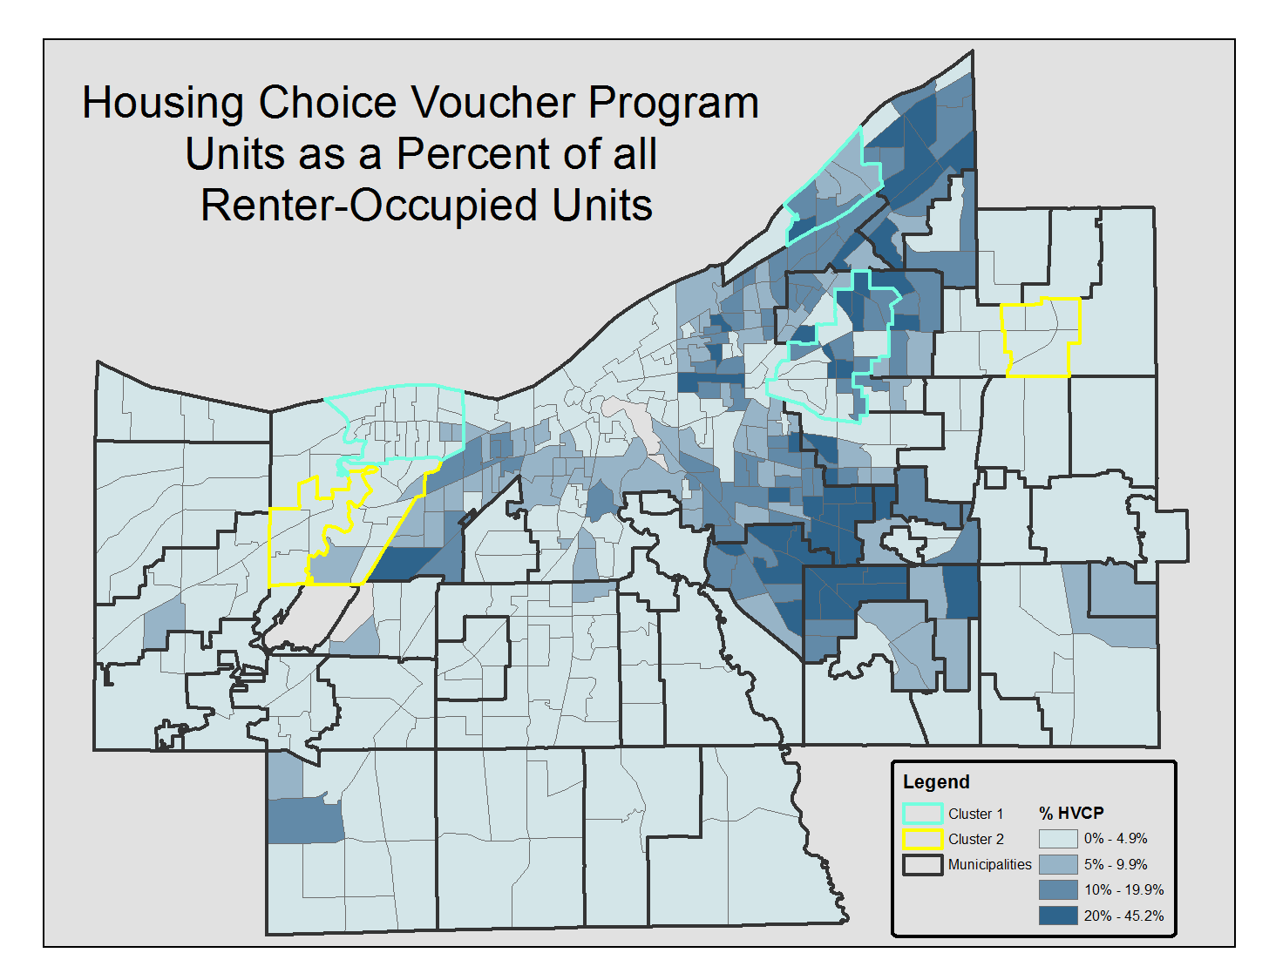
Notes:
More than 70% of HCVP units are in census tracts where they comprise less than 20% of all rental occupied units.
Voucher holders live in almost every community in Cuyahoga County but they are concentrated in 9 east side suburbs and in the neighborhoods of Cleveland’s East side:
Euclid, Cleveland Hts., Maple Hts., Garfied Hts., East Cleveland, Bedford Heights, Shaker Heights, Warrenscville Heights, and South Euclid.
Cluster 1 (concentrated): Cleveland Hts., Lakewood, North Collinwood
Cluster 2 (not concentrated): Mayfield Hts., Fairview Park, Kamm’s

Slide 5
Summary: HCVP Concentrated Tracts
30% of HCVP units are in concentrated areas
Minorities are 3x as likely to live in concentrated areas as white voucher holders
Residents in CAs move more often
Residents in CAs pay higher rents
Notes:
CA=concentrated area

Slide 6
Top 5 Factors Considered When Choosing a Neighborhood
Factor | New Voucher Holder |  | Movers
 | Current | Future | Current | Future
Affordability | 1 | 2 | 2 | 2
Safety | 2 | 1 | 1 | 1
Close to Shopping | 3 | 4 | 3 | 3
Friendly Neighbors | 4 | 5 | 5 | 4
Public Transit | 5 | 6 | 4 | 6
Schools | 6 | 3 | 5 | 5
Notes:
Surprisingly, close to job or job opportunities were not among the top 5.

Slide 7
Other Desired Neighborhood Characteristics
Access to public transportation
Recreation facilities, senior services, hospitals, churches, parks, and city services (including police response time).
Current and former police officers as neighbors
Nearby employment
Proximity to grocery stores and shopping
Notes:
Provide voucher holders with information about these factors in communities across cuyahoga county.
Include an exercise that illustrates the type of questions to ask or identifies sources for ratings of these factors.
Objective measures and clear communication

Slide 8
Importance of Quality Schools for those with Children
Type | Number of HH with Children | Schools are important |  | Schools are most important
 |  | Number | Percent | Number | Percent
New Voucher Holders | 63 | 39 | 62% | 11 | 17%
Movers | 49 | 29 | 59% | 11 | 22%
Total | 112 | 68 | 61% | 22 | 20%
Notes:
Thought quality of schools would have been higher on the list.

Slide 9
Search challenges and resources
Finding a nice neighborhood is a problem whether in a suburb or not.
Choices were limited and not all places listed accepted the voucher.
Understanding rent eligibility and allowances for different communities.
GoSection8 and HousingCleveland.org were not useful sources of housing choice information.
More helpful sources included Craigslist, newspapers, rent books, relatives, a VA caseworker (who provided a list), word-of-mouth, and scouting for “for rent” signs.

Slide 10
What would help your housing search?
An up-to-date listing of available units and landlords, especially in the suburbs/county and outside of the county (Portability)
Extend the search period
Conduct landlord outreach and screening; Expand the pool of good landlords willing to accept vouchers
Assistance with transportation to see available units
Incentives to search and move to non-concentrated areas
Dispel stereotypes about HCV residents
Notes:
Clarity on voucher allowance
Have landlords with positive stories share them with other landlords.

Slide 11
How do landlords find tenants?
Word of mouth or referrals
Newspaper ads or online listings
Only one used CMHA listings
Notes:
Large property ownrs relied more on word of mouth and referrals.

Slide 12
Recommendations to improve search
Provide complete and accurate information about neighborhood attributes
Provide complete and up-to-date listings of available units, especially those that accept vouchers
Improve communication and personalize search assistance and post-move support
Provide transportation assistance if needed
Provide moving assistance (e.g., security deposits)
Assist tenants to understand their rights as tenants
Extend search period
Notes:
Literature Review, Surveys, Focus Groups are all consistent:
These are the things that are important in the search process and successful retention/
These are suggested by the literature for getting people to move to areas of opportunity.

Slide 13
Increase housing options for voucher holders
Outreach to communities and landlords to build bridges, dispel myths
Showcase real, successful tenants
Create an advisory committee—landlords, tenants and cities to provide feedback and troubleshoot. Give them a voice in the process.
Continuous improvement model
Notes:
Meet regularly with city officials including housing officials, mayors council members.

Slide 14
Understanding the Location Decisions of CMHA Housing Choice Voucher Holders: Pilot Study, February 28, 2015
by Kathryn W. Hexter, W. Dennis Keating, Mittie Davis-Jones, Brian Mikelbank, Michael Veres, Joyce Huang
http://engagedscholarship.csuohio.edu/urban_facpub/1282/

